Slide 1

Banking System With JDBC
Name : Sahital Patil
Batch : 4

Slide 2
Content
Java
JDBC Connections
Scope Of Project
Project Configurations
Dependencies
Functional Requirements
Operating Environments
Hierarchy Of Project Artifacts

Slide 3
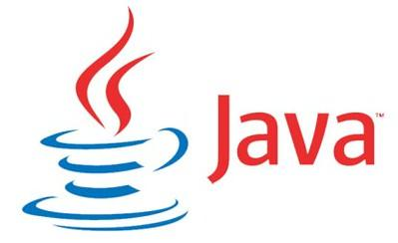
Java
Java is a versatile, object-oriented, and platform-independent programming language that was first developed by Sun Microsystems in 1995. Java is designed to be simple, secure, and portable, making it suitable for a wide range of applications, from mobile and web development to enterprise-level systems.
Key features of Java include:
Object-Oriented
Platform-Independent
Security
Enterprise-Level Development
Community Support
Rich Standard Library
Multi-threading

Slide 4
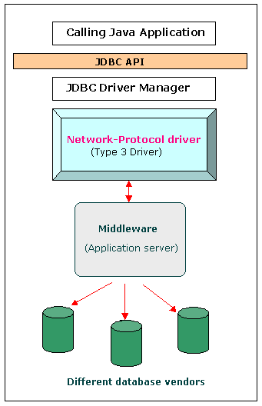
JDBC
JDBC, which stands for Java Database Connectivity, is a Java-based API (Application Programming Interface) that allows Java applications to interact with relational databases.
Basic Steps in JDBC:
Loading the Database Driver
Establish the Connection
Create the Statement
Execute the Statement and Returning ResultSet object
Retrieving the data returned by the Statement

Slide 5
Scope of Project:
The code focuses on processing transactions, displaying records, and closing the database connection.
Typical functionalities in banking systems.
1. Transaction Processing:
Implement various transaction types such as deposits, withdrawals.
Ensure proper validation and authorization checks for transactions.
Handle transaction failures and provide appropriate error messages.
2. Displaying All Transactions:
The displayAllRecords method serves as the entry point for displaying records from different transaction tables.
Calls three separate methods to display records from the main transactions table, the ValidTrans table, and the InValidTrans table.
3. Database Connection:
The class maintains a single static connection (con) throughout its lifecycle, obtained from the ConnectionProvider class.

Slide 6
Project Configuration :
1. Database Configuration:
Database URL, Username, and Password
Externalize the database connection details (URL, username, password) to a configuration file or environment variables.
private static final String URL = "jdbc:oracle:thin:@localhost:1521:XE";
private static final String USERNAME = "shital";
private static final String PASSWORD = "patil";
2. Exception Handling Configuration:
Define error messages or error codes in external files for consistent error handling.
# error_messages.properties
error.database.connection=Error connecting to the database.
3. Connection String i.e JDBC URL :
private static final String URL = "jdbc:oracle:thin:@localhost:1521:XE";

Slide 7
Dependencies
1. Dependencies
Ojdbc14.jar:
The ojdbc14.jar file is a JDBC (Java Database Connectivity) driver for Oracle Database 10g and 9i. This driver allows Java applications to connect to and interact with Oracle databases.
2. OracleDriver:
The OracleDriver class is a part of the Oracle JDBC (Java Database Connectivity) driver. It's specifically related to Oracle Database and serves as the implementation of the Driver interface for Oracle's JDBC driver.
3. Tnasnames.ora:
The tnsnames.ora file is a configuration file used by Oracle Database clients to define database connection information. It provides a mapping between a logical database alias and the corresponding network address, enabling clients to connect to the Oracle Database.

Slide 8

Components
BASE CLASS : Test
JDBCConnection Class :
DAO Classes :
primary class responsible for managing bank transactions and run entire functionality.
1.class responsible for managing database connections.
2.use of the singleton pattern to ensure a single connection instance.
ØFetchTransactions
ØInsertTransactions
ØUpdateTransactions
ØDisplayAllTransactions

Slide 9

Utility Methods
Method :
calculateNewBalance
Ø method responsible for
calculating the new balance
based on transaction type.
updateTransactions
Ø method responsible for
updating transaction details
in the database.
Method :
insertIntoTransaction
Ø method responsible for
Inserting transactions into appropriate tables.
DisplayAllTransactions
Ø method responsible for
displaying all transactions in all tables
Method :
getConnection
Ø method responsible for
obtaining database connection.
closeConnection
Ø method responsible for
closing the database connection

Slide 10
Method Chaining
1. Programming technique known as "method chaining" entails invoking
several methods on an object within a single, continuous line of code.
2. Every method in a method chain is called based on the outcome of the
one before it, and the process keeps going until the intended tasks are finished.
3. It enhances code readability and conciseness, making complex operations more straightforward.

Slide 11
Operating Environment
Database and Server:
MySQL Server: Ensure proper configuration.
Version: Compatible with MySQL,
specify the version.
Java Environment:
JRE Version: Specify the required Java Runtime Environment version.
Dependencies: List necessary libraries or dependencies.
Development Environment:
Integrated Development Environment (IDE): Mention the IDE used for development (e.g., IntelliJ IDEA, Eclipse).
Network and Configuration:
Connection: Stable network connection to the MySQL database server.
Ports: Specify required open network ports.
Security: Briefly mention security measures and configuration files.

Slide 12
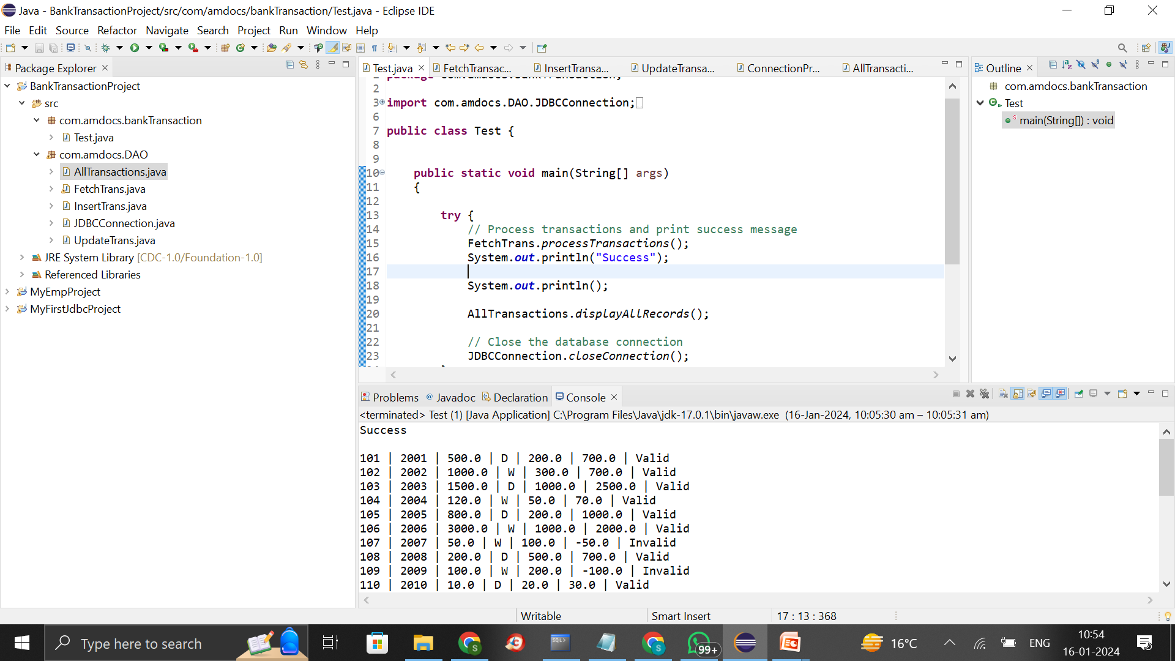
Hierarchy of Project Artifacts

Slide 13
THANK YOU

